Slide 1
Think Globally and Act Locally
Religious Social Action Coalition of Newfoundland and Labrador

Slide 2
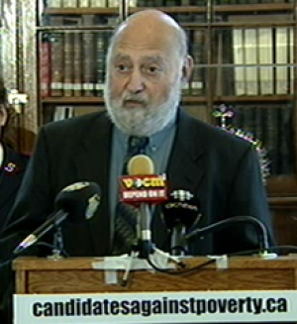

Slide 3
When was it established
“Acts of justice are acts of responsibility. It is our responsibility as people of faith, as citizens of the community and as human beings of the world to act justly – to narrow that gap between the rich and the poor in our province, in our country and world – indeed, to eliminate poverty”
Challenged members of different faiths to move from discussion to action
In response the Coalition of members of all most all faith communities in Newfoundland and Labrador was founded in spring of 2007.

Slide 4
How does RSAC function
Although the membership has been affiliated with various religions, we all participate in RSAC in our individual capacity without compromising the doctrines of our parent religious affiliations. Still, most of those on the Executive Committee required a tacit nod from their organization for being a director of RSAC.

Slide 5
Vision Statement
Religious Social Action Coalition (RSAC) of Newfoundland and Labrador is a voice of consciousness and moral persuasion in the NL society at large which aspires to be a catalyst for social change to achieve productive and dignified life for all members of the society, where nobody is denied a decent standard of living, education, economic and social equity and quality of life. More specifically, RSAC is committed to working towards poverty elimination in our society.

Slide 6
Who are we representing
Anglican
Baptist
Buddhist
Hindu
Jewish
Moravian
Mennonite
Muslim
Pentecostal
Presbyterian
Roman Catholic
Salvation Army
Sikh
Unitarian Universalist and
United Church of Canada

Slide 7
Gap between rich and poor greater than most Canadians think www.thestar.com/.../gap_between_rich_and_poor_greater_than_most_ca...Dec 16, 2014
The study, published by the Broadbent Institute, drew its results from an online poll of 3,000 people.
The findings said that Canadians believe the richest fifth of the country own about 55 per cent of wealth, and thought the poorest fifth held about 6 per cent.
In reality, the gap is much starker. The richest segment of Canada’s population controls close to 70 per cent of the country’s wealth. Its very poorest segment has a small share.

Slide 8
Gap between rich and poor greater than most Canadians think
“There’s a huge discrepancy between the kind of Canada that people want and the kind of Canada that actually exists.”
The research showed a strong appetite for government intervention to alleviate income inequality, with over 85 per cent of the country agreeing that the wealth gap was a problem.
“In public policy terms, that’s nearing unanimity.”

Slide 9
Canadian Incomes Stagnated Even as Economy Grew in 2013 The Huffington Post Canada: Daniel Tencer Posted: 07/08/2015 2:04 pm EDT Updated: 07/08/2015
The top 10 per cent — or top decile — of earners saw their after-tax income rise on average by $100, to an average of $183,600.
By contrast, the bottom 10 per cent saw their average income shrink by the same amount, to $9,200 per year from $9,300 a year earlier.
Based on adjusted after-tax income, Canadians in the highest decile accounted for 23.7 per cent of total after-tax income in Canada in 2013, while the lowest decile represented 2.5 per cent.

Slide 10
RSAC as an organization
RSAC is neither a social enterprise nor a charitable organization
It is not registered as a not-for-profit organization.
It is a fairly loose coalition of religious people with common objectives of social justice, particularly pertaining to poverty.
Recognize that poverty has many facets and therefore requires diverse mechanisms to reduce it.

Slide 11
RSAC as an organization
RSAC has in general terms supports all measures for addressing, eliminating poverty and reducing the gap between rich and poor
We can do anything, but we can’t do every thing: General Sec.
RSAC’s focus is on effecting changes in more visible non antagonist aspects only, such as poverty levels, living wages, income gap, fairness prism etc., through policy changes at the government levels

Slide 12
RSAC’s activities
RSAC has engaged in the following activities
Raising public awareness about poverty and income gap through media and through places of worship.
Raising questions on why poverty rates are increasing
Launching candidates against poverty initiative http://rsacnl.com/
Meetings with elected officials and government members.
Letter writing campaigns to members of Parliament & Legislature and Senate.
Participating in public consultations on government poverty reduction strategy of the provincial government.
Raising the issue of increasing the minimum wage.

Slide 13
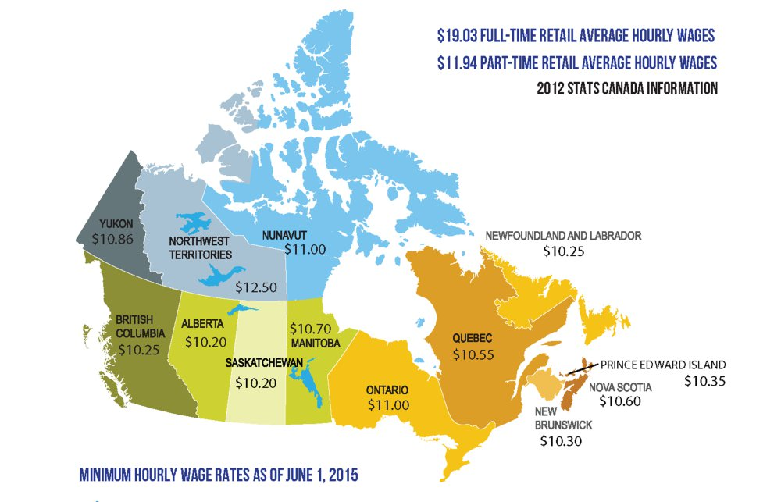
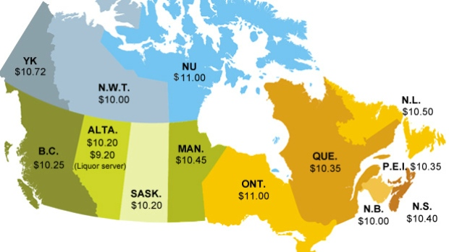

Slide 14
RSAC’s activities
Monitoring the data on gap between the rich and poor and advocating the narrowing of the gap.
Advocating the monitoring the number of people below low income cut off or NL Market Basket Measure.
Advocating for the allocation of funds from off shore oil revenue to social programs directed at narrowing the income gap and poverty rates.
Approaching the government for adopting a Fairness Prism in order to evaluate the impact of government legislation, programs and policies on income gap and poverty levels.
Discussions around Living Wage.

